Slide 1
Chapter 3: Probability Density Estimation
Introduction
Parametric Estimation
Nonparametric Estimation

Slide 2
3.1 Introduction
There are two kinds of information should be given in advance when using the rule of Bayesian Decision Theory:
  the prior probability of each class P(W_{i})；
  the conditional probability of each class P(X|Wi).
It is easy to achieve the prior probability of each class P(W_{i}) based on our daily experience.
It is difficult to achieve the conditional probability of each class P(X|Wi) since the distribution information of each class needs to be deduced from the training samples.

Slide 3
Chapter 3: Probability Density Estimation
Introduction
Parametric Estimation
Nonparametric Estimation

Slide 4

3.2 Parametric Estimation
Parameter estimation: given observed data X depending on unknown parameter(s) α, the purpose is to obtain the expression of α.
The first type of method is to obtain the expression of deterministic but unknown parameters α using the maximum likelihood estimate strategy.

Slide 5
3.2.1 Parametric Estimation: Maximum Likelihood Estimation
Assume we have n observed samples which are impendence of each other.
Obtain the expression of deterministic but unknown parameters α using the maximum likelihood estimate strategy

Slide 6
3.2.1 Parametric Estimation: Maximum Likelihood Estimation
Process of estimating parameters using the maximum likelihood estimation strategy:
  (1) Extracting N samples independently and achieving the corresponding likelihood function;
  (2) Obtaining the form of log-likelihood function;
  (3) Obtaining the form of the partial derivative for the log-likelihood function;
  (4) Obtaining the form of parameters using the maximum likelihood estimation method.

Slide 7
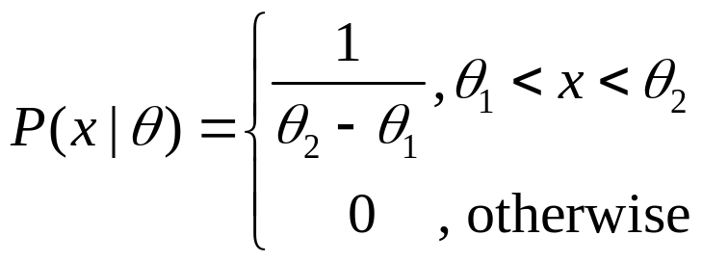
Illustration example of uniform distribution
If the observed data follows the uniform distribution with deterministic but unknown θ₁ and θ₂ and each data is independence of each other:
Determination of parameters θ₁ and θ₂ using maximum likelihood estimates.

Slide 8
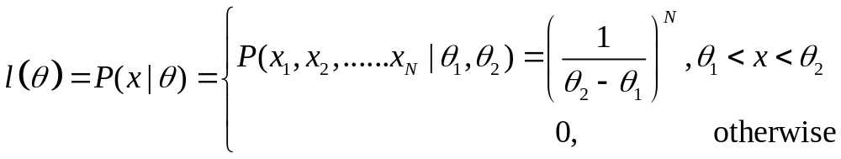
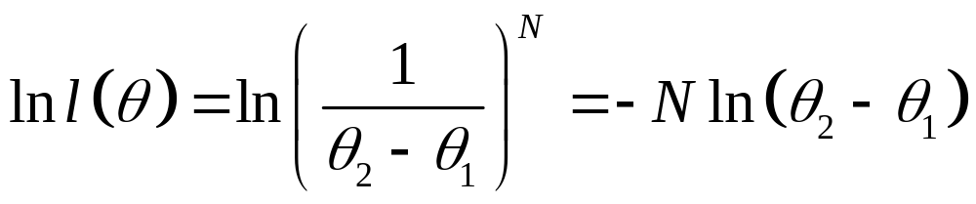
Illustration example of uniform distribution
First: extracting N samples independently and achieving the corresponding likelihood function:
Second: the form of the log-likelihood function is:

Slide 9
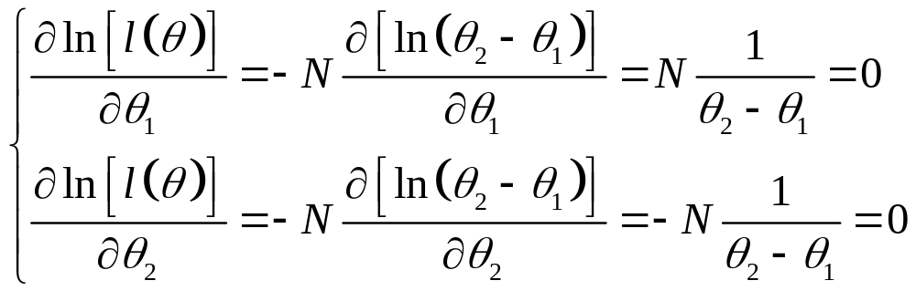
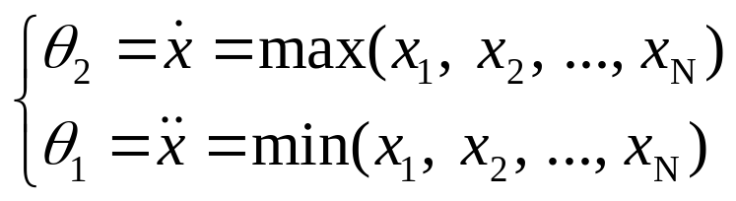
Illustration example of uniform distribution
Third: the form of the partial derivative for the log-likelihood function is:
Fourth: the maximum likelihood estimation of θ₁ and θ₂ are:

Slide 10
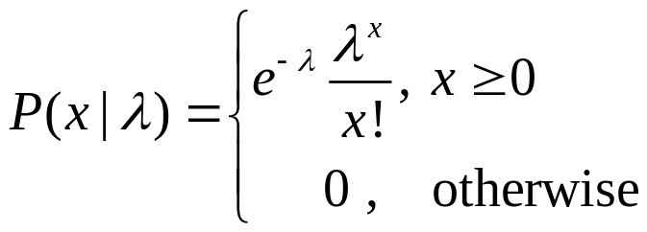
Illustration example of Poisson distribution
If the observed data (x₁, x₂, …, x_{N}) follow the Poisson distribution with an deterministic but unknown λ and each data is independence of each other :
Determination of parameter λ using the maximum likelihood estimation method.

Slide 11
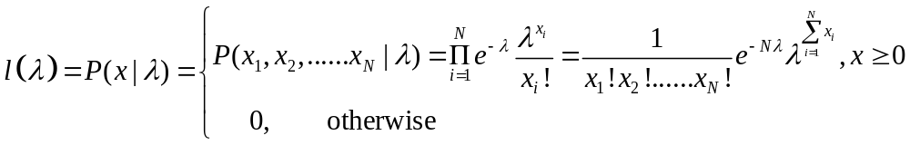
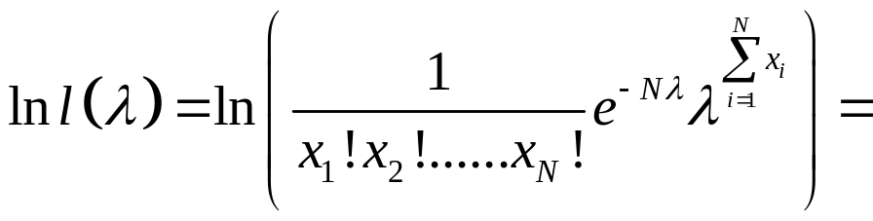
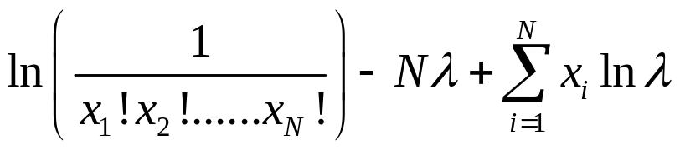
Illustration example of Poisson distribution
First: extracting N samples independently and achieving the corresponding likelihood function:
Second: the form of the log-likelihood function is:

Slide 12
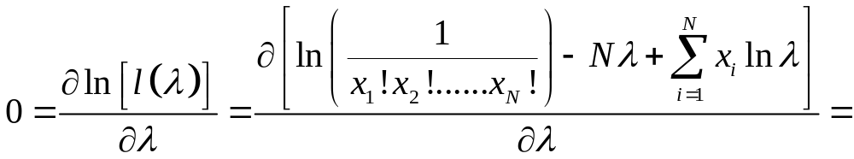
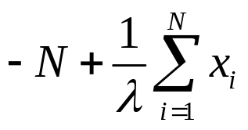
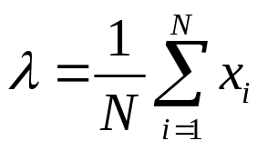
Illustration example of Poisson distribution
Third: the form of the partial derivative for the log-likelihood function is:
Fourth: the maximum likelihood estimation of λ is:

Slide 13
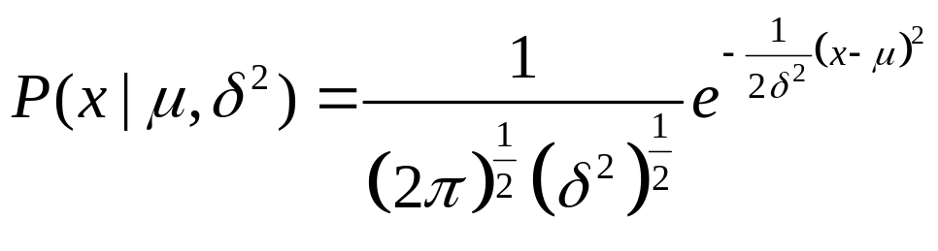
Illustration example of Gaussian distribution
If the observed data (x₁, x₂, …, x_{N}) follow the Gaussian distribution with an deterministic but unknowns μ and δ² where each data is independence of each other :
Determination of parameters μ and δ² using the maximum likelihood estimation method.

Slide 14
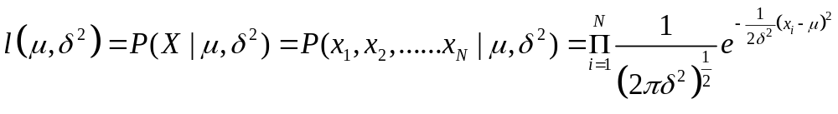
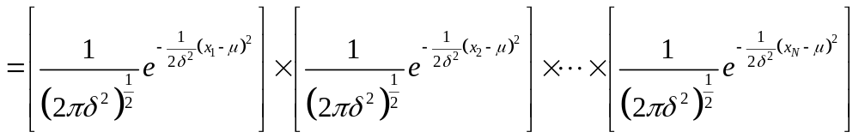
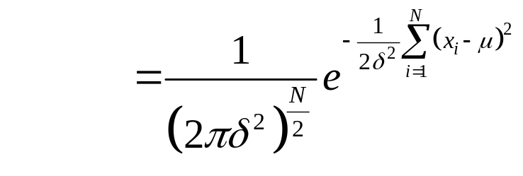
Illustration example of Gaussian distribution
First: extracting N samples independently and achieving the corresponding likelihood function:

Slide 15
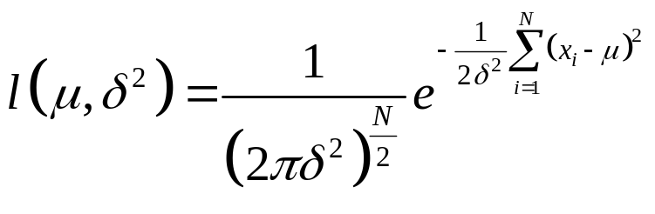
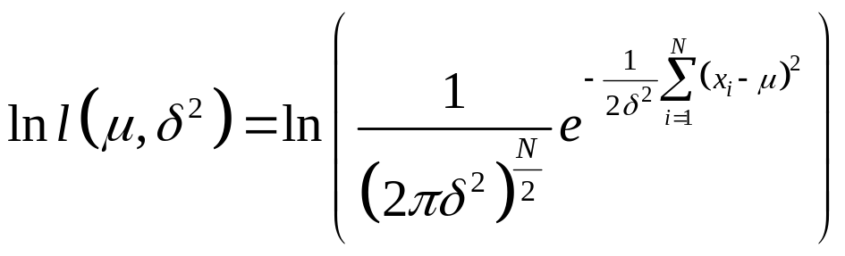
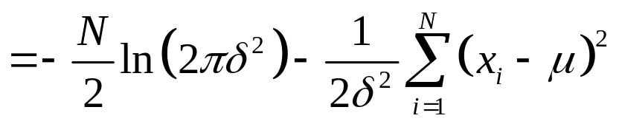
Illustration example of Gaussian distribution
First: extracting N samples independently and achieving the corresponding likelihood function:
Second: the form of the log-likelihood function is:

